Slide 1

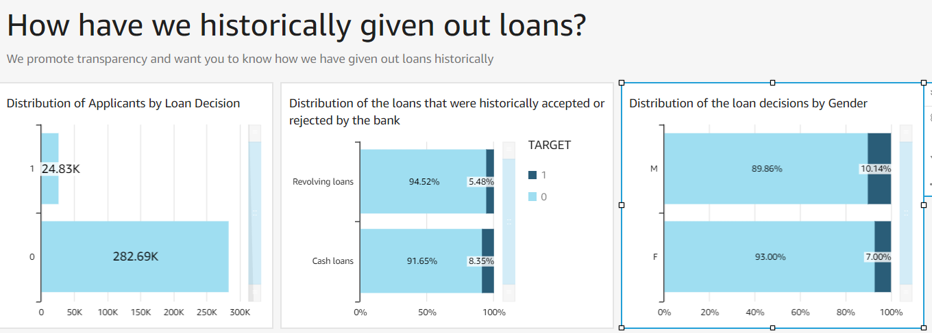
Using AWS Quicksight to analyze historical decisions visually
Using AWS Quicksight, all decisions made by the finance agency can be analyzed and visualized for the end business user.
The environment could potentially help identify any biases in the system and alert them to make a timely intervention
- % Loans Approved, Types of Loans accepted or rejected, presence of gender bias in loan disbursal
Notes:
Technologies used for each step of the modeling process.

Slide 2
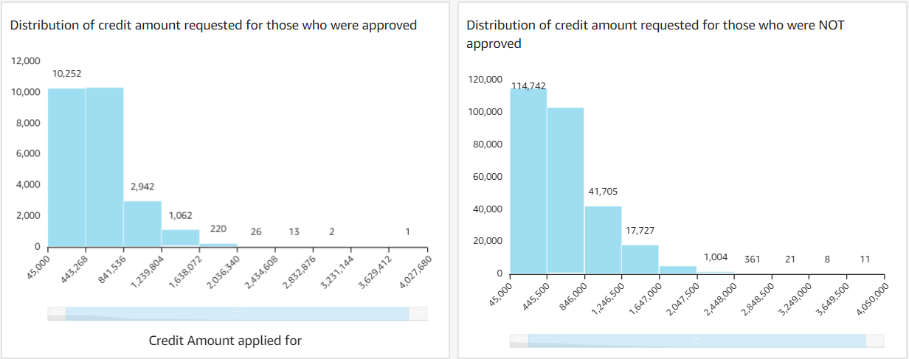
Using AWS Quicksight to analyze historical decisions visually
Notes:
Technologies used for each step of the modeling process.

Slide 3
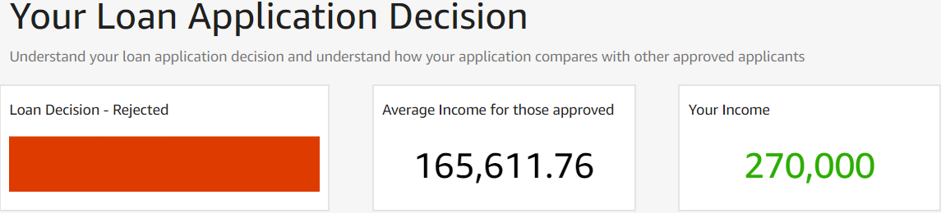
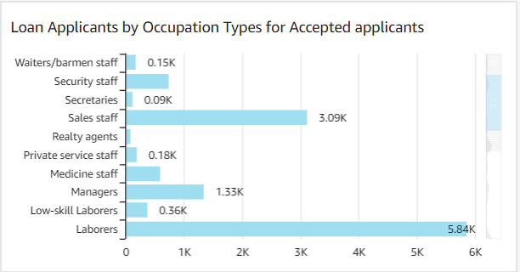
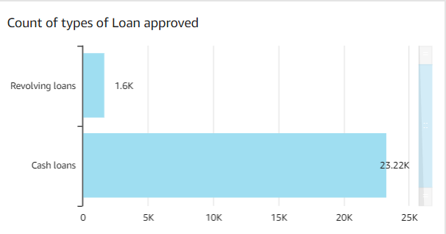
Easily visualize the results of a customer's loan application and provide benchmarks for decision
The results of an applicant’s loan decision made using Sage maker can be benchmarked and visualized for the customer using Quicksight and the bank to analyze.
This could help the customer digest why the decision was made
Your Occupation – “Core Staff”
Loan Applied for– “Cash Loan”
Notes:
Technologies used for each step of the modeling process.

